Slide 1
Analyzing Conversion Rates with Bayes Rule
By Alexander Booth

Slide 2
Analyzing conversion rates with Bayes Rule
Purpose:
This quick tutorial will outline how to analyze a success metric in the Bayesian sense.

Slide 3
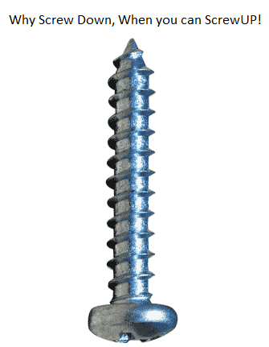
Analyzing conversion rates with Bayes Rule
Scenario:
McMaster-Carr has just launched a new app, ScrewUp. It's a hip little app matching people who love screws with specialty screws in our catalog.
Our marketing team has gotten some early publicity by advertising on Google…

Slide 4
Analyzing conversion rates with Bayes Rule
Scenario:
The initial result was 794 unique visitors of whom 12 created an account.
After doing some intense division I have computed an empirical conversion rate of 12/794=1.5%

Slide 5
Analyzing conversion rates with Bayes Rule
Scenario:
We can expose the app to 10,000 people. What is the expected conversion rate?

Slide 6
Analyzing conversion rates with Bayes Rule
Scenario:
We can expose the app to 10,000 people. What is the expected conversion rate?
10,000 * 1.5 = 150

Slide 7
Analyzing conversion rates with Bayes Rule
Scenario:
How confident are we that we will really see 150 signups?
How confident are we that the conversion rate is really higher than 1%? (Estimate is 1.5%)

Slide 8
Analyzing conversion rates with Bayes Rule
Bayesian Basics
There exists an (unknown) parameter θ∈[0,1]
A unique visitor who sees our ScrewUP ad will create an account with probability θ
θ is our true conversion rate

Slide 9

Analyzing conversion rates with Bayes Rule
Bayesian Basics
The fundamental goal is to compute a probability distribution on θ so that:

Slide 10
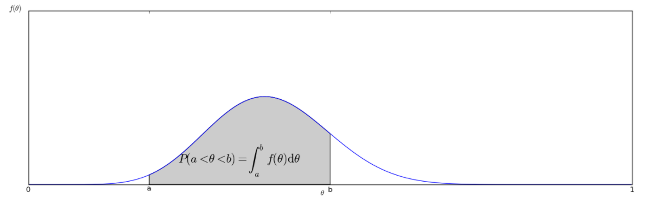
Analyzing conversion rates with Bayes Rule
Bayesian Basics

Slide 11

Analyzing conversion rates with Bayes Rule
Bayes’ Rule
Update f(θ), our belief, based on evidence

Slide 12
Analyzing conversion rates with Bayes Rule
Bayes’ Rule
P(fact) is our Prior distribution and is purely subjective. It represents our beliefs before we have gathered any evidence
P(fact|evidence) is our Posterior distribution and is our estimator of f(θ)

Slide 13

Analyzing conversion rates with Bayes Rule
Beta Distribution
A common choice for the underlying choice of model is the Beta Distribution
The Beta Distribution is used for both the Prior function and the Posterior function

Slide 14
Analyzing conversion rates with Bayes Rule
Beta Distribution
the Beta distribution can be understood as representing a distribution of probabilities
It represents all the possible values of a probability when we don't know what that probability is

Slide 15
Analyzing conversion rates with Bayes Rule
Beta Distribution
Two parameters:
Alpha = # of successes
Beta = # of failures

Slide 16
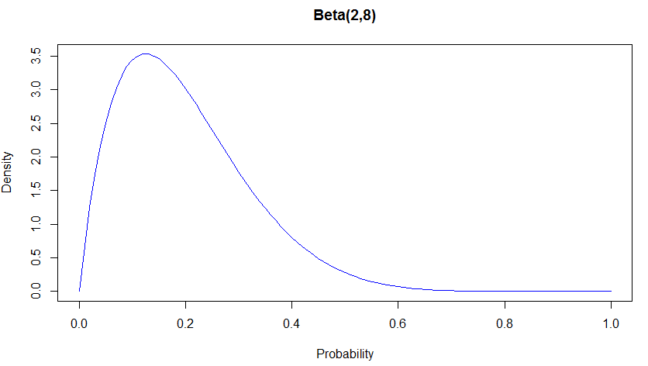
Analyzing conversion rates with Bayes Rule
Beta Distribution

Slide 17
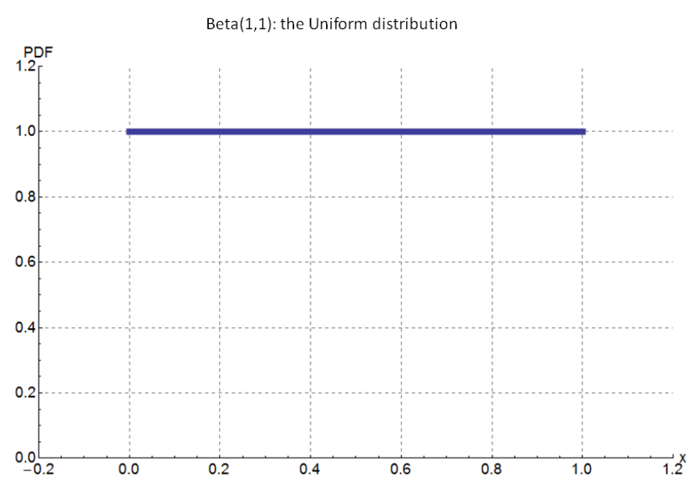
Analyzing conversion rates with Bayes Rule
Popular Uniformed Priors
f_{1,1}(θ), Bayes’ Prior
All potential probabilities are equal

Slide 18
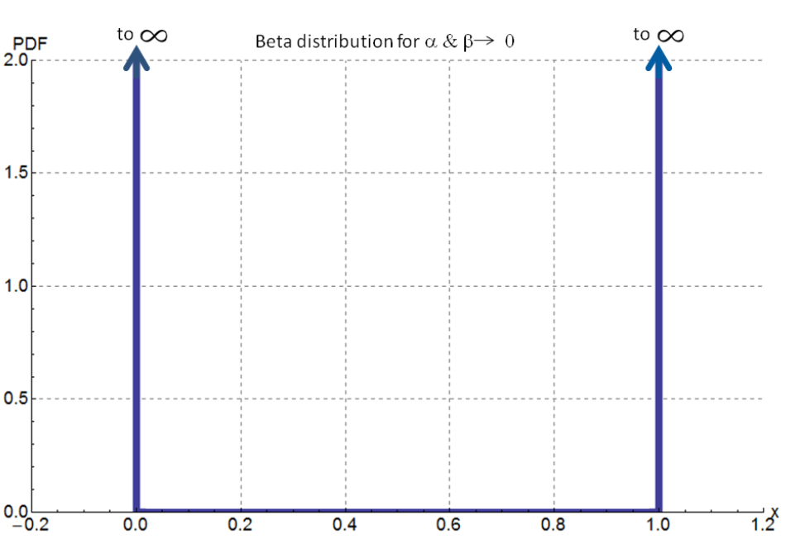
Analyzing conversion rates with Bayes Rule
Popular Uniformed Priors
f_{0,0}(θ), Haldane’s Prior
It either happens always, or never

Slide 19

Analyzing conversion rates with Bayes Rule
Calculating Posterior
Given a prior f_{α,β}(θ) with alpha and beta
Plus N trials and K observed successes
Plus Math results in:

Slide 20
Analyzing conversion rates with Bayes Rule
Calculating Posterior
Confused? Don’t be! Here are 4 Easy Steps:
Step 1: Pick a prior. f(1,1) or f(0,0) are good choices

Slide 21
Analyzing conversion rates with Bayes Rule
Calculating Posterior
Confused? Don’t be! Here are 4 Easy Steps:
Step 1: Pick a prior. f(1,1) or f(0,0) are good choices
Step 2: Observe N trials, with K success and F failures
E.g 794 people saw the ad, 12 signed up, 782 didn’t

Slide 22
Analyzing conversion rates with Bayes Rule
Calculating Posterior
Confused? Don’t be! Here are 4 Easy Steps:
Step 1: Pick a prior. f(1,1) or f(0,0) are good choices
Step 2: Observe N trials, with K success and F failures
E.g 794 people saw the ad, 12 signed up, 782 didn’t
Step 3: Do simple addition to calculate new alpha or beta. This is optional if you pick the f(0,0) prior

Slide 23
Analyzing conversion rates with Bayes Rule
Calculating Posterior
Confused? Don’t be! Here are 4 Easy Steps:
Step 1: Pick a prior. f(1,1) or f(0,0) are good choices
Step 2: Observe N trials, with K success and F failures
E.g 794 people saw the ad, 12 signed up, 782 didn’t
Step 3: Do simple addition to calculate new alpha or beta. This is optional if you pick the f(0,0) prior
Step 4. New Alpha = Prior Alpha + K
New Beta = Prior Beta + F

Slide 24
Analyzing conversion rates with Bayes Rule
Calculating Posterior
Prior = Uniform Beta = f_{1,1}(θ)
N = 794, K = 12, F = 782
Alpha = 1, Beta = 1
Posterior = f_{1+12, 1+782}(θ)
Posterior = f_{13, 783}(θ)

Slide 25
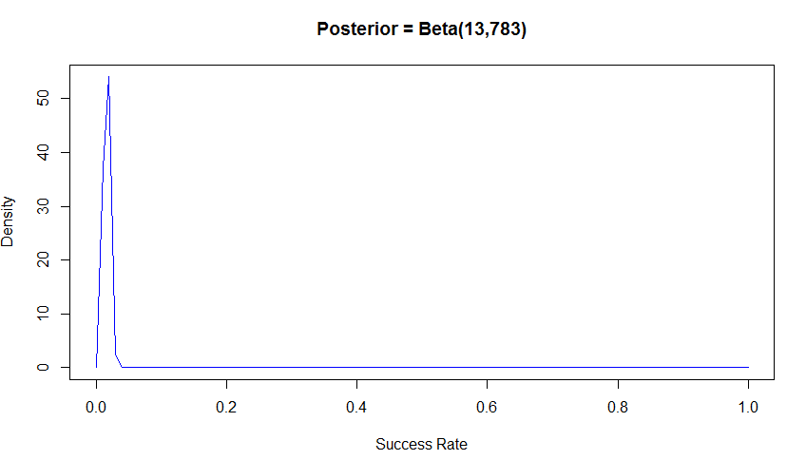
Analyzing conversion rates with Bayes Rule
Calculating Posterior

Slide 26
Analyzing conversion rates with Bayes Rule
Calculating Probability
Probability that our true conversion rate is greater than 1%?
Just integrate f_{13, 783}(θ) from .01 to 1!

Slide 27
Analyzing conversion rates with Bayes Rule
Calculating Probability
Probability that our true conversion rate is greater than 1%?
= 0.94 = 94% that the true conversion rate is greater than 1%

Slide 28
Analyzing conversion rates with Bayes Rule
Using a Prior from Intuition or Business Domain Knowledge
We could choose a prior based on our intuition about advertising conversion rates.
When does this matter most?
Small sample sizes
The astute among you may have already noticed the Beta(2,8) graph was a lot wider, without a narrow spike when compared to Beta(13,783). Good work.

Slide 29
Analyzing conversion rates with Bayes Rule
Using a Prior from Intuition or Business Domain Knowledge
Of the first 5 people to see our ad, 2 created an account!
Do we really have a 40% conversion rate though?
Using uninformed prior of Beta(0,0) gives a posterior function =
= Beta(2+0, 3+0) = Beta(2,3)

Slide 30
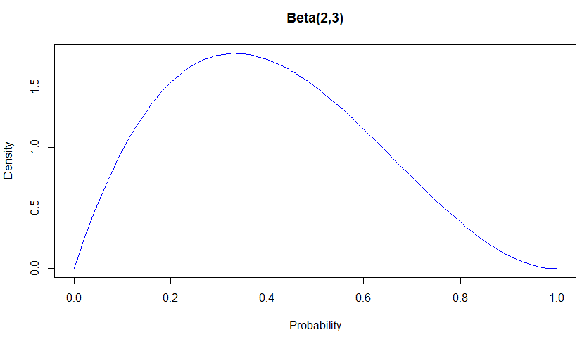
Analyzing conversion rates with Bayes Rule
Using a Prior from Intuition or Business Domain Knowledge

Slide 31
Analyzing conversion rates with Bayes Rule
Using a Prior from Intuition or Business Domain Knowledge
Unlike the last example, where we had a pretty narrow spike, we have this huge range of possible values.
Our true conversion rate could be pretty much anything between 0.05 and 0.8!
This reflects the very little information that we actually have acquired so far.
Notes:
Given that we have had 2 conversions we know the true rate can't be 0, and we also know that it can't be 1 since we've had 3 people not convert. Everything else is pretty much fair game.

Slide 32
Analyzing conversion rates with Bayes Rule
Using a Prior from Intuition or Business Domain Knowledge
Hold your horses though. We may be new to the app advertising department, but an 80% sign up rate still sounds really high.
Doing some quick research, we know that similar ads for mobile apps garner a 2.5% conversion rate. How do we map that to a Beta function?

Slide 33
Analyzing conversion rates with Bayes Rule
Using a Prior from Intuition or Business Domain Knowledge
Possible Priors for a 2.5% conversion rate:
We want alpha/(alpha+beta) = 2.5%
But which to pick?
Beta(1,40)
Beta(2, 80)
Beta(5,200)

Slide 34
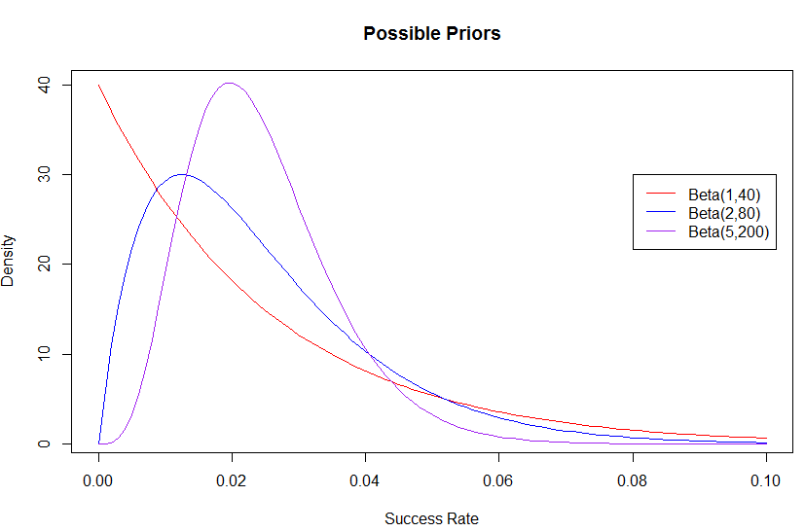
Analyzing conversion rates with Bayes Rule
Using a Prior from Intuition or Business Domain Knowledge
Possible Priors for a 2.5% conversion rate:

Slide 35
Analyzing conversion rates with Bayes Rule
Using a Prior from Intuition or Business Domain Knowledge
Possible Priors for a 2.5% conversion rate:
The lower the combined alpha + beta, the wider our distribution is.
Different Beta distributions can be used to represent different strengths of belief in the same data.

Slide 36
Analyzing conversion rates with Bayes Rule
Using a Prior from Intuition or Business Domain Knowledge
Possible Priors for a 2.5% conversion rate:
Our beliefs aren’t too strong, so we’ll just take the most pessimistic prior. The world is a cold, dark place after all
Beta(1,40) which gives a new posterior of Beta(3,43)
Let’s compare this to the other posterior Beta(2,3) calculated from an uninformed prior of Beta(0,0)

Slide 37
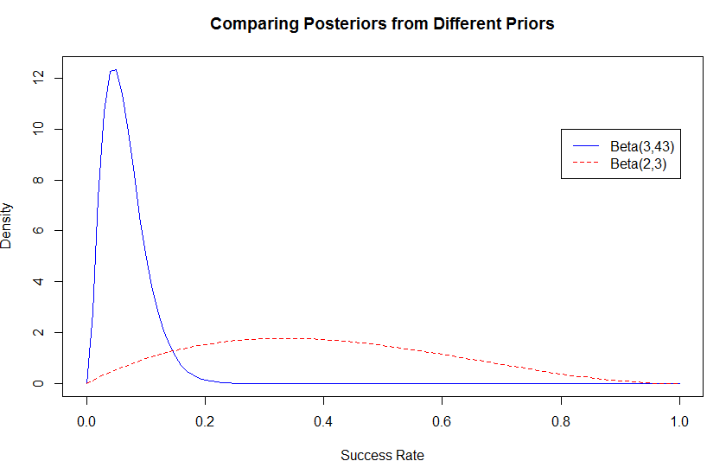
Analyzing conversion rates with Bayes Rule
Using a Prior from Intuition or Business Domain Knowledge

Slide 38
Analyzing conversion rates with Bayes Rule
Using a Prior from Intuition or Business Domain Knowledge
Adding a Prior Probability can drastically improve estimates from small sample sizes!
We can definitely throw out the chance that we have a conversion rate between 40% and 80%. But how can we know for sure?
GATHER MORE DATA

Slide 39
Analyzing conversion rates with Bayes Rule
Using a Prior from Intuition or Business Domain Knowledge
After a few more hours, we notice that 25 of 100 people have created an account after seeing our ad.
Prior = Beta(0,0), Posterior = Beta(25,75)
Prior = Beta(1,40), Posterior = Beta(26, 115)

Slide 40
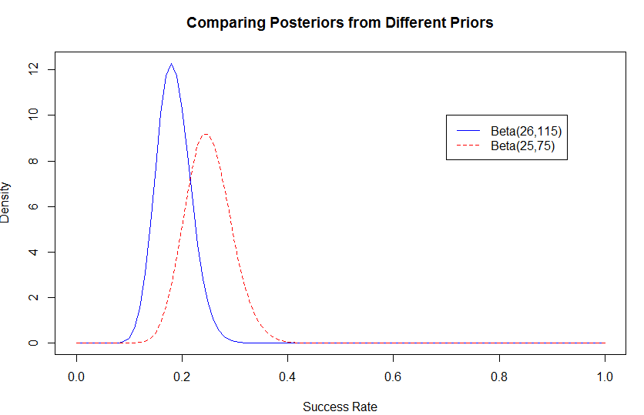
Analyzing conversion rates with Bayes Rule
Using a Prior from Intuition or Business Domain Knowledge

Slide 41
Analyzing conversion rates with Bayes Rule
Using a Prior from Intuition or Business Domain Knowledge
The next morning, we notice that 85 of 300 people have created an account after seeing our ad.
Prior = Beta(0,0), Posterior = Beta(85,215)
Prior = Beta(1,40), Posterior = Beta(86, 255)

Slide 42
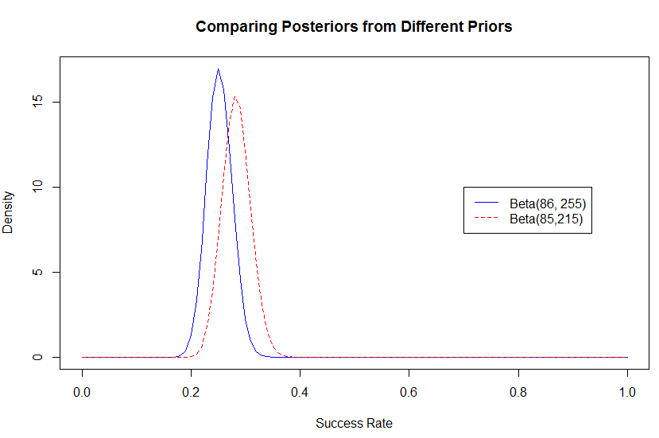
Analyzing conversion rates with Bayes Rule
Using a Prior from Intuition or Business Domain Knowledge

Slide 43
Analyzing conversion rates with Bayes Rule
Using a Prior from Intuition or Business Domain Knowledge
What have we learned then?
1) When we had no evidence our Likelihood proposed some things we know are absurd.

Slide 44
Analyzing conversion rates with Bayes Rule
Using a Prior from Intuition or Business Domain Knowledge
What have we learned then?
When we had no evidence our Likelihood proposed some things we know are absurd.
In light of little evidence, our Prior beliefs squashed any data we had.

Slide 45
Analyzing conversion rates with Bayes Rule
Using a Prior from Intuition or Business Domain Knowledge
What have we learned then?
When we had no evidence our Likelihood proposed some things we know are absurd.
In light of little evidence, our Prior beliefs squashed any data we had.
As we continue to gather data that disagrees with our Prior our Posterior beliefs shift towards what the data tells us and away from what our initial thoughts were

Slide 46
Analyzing conversion rates with Bayes Rule
Using a Prior from Intuition or Business Domain Knowledge
What have we learned then?
Bonus:
Another important thing to realize is that we started with a pretty pessimistic prior.
Even after just a small time period of collecting a relatively small set of information we were able to find a Posterior that seems much, much more reasonable.

Slide 47
Analyzing conversion rates with Bayes Rule
Using a Prior from Intuition or Business Domain Knowledge
What have we learned then?
The most important thing to realize?
The more data we gather, the more our Prior beliefs become diminished by evidence!
Thus, with large amounts of data collected, it can be fine to use an uninformed prior

Slide 48
Analyzing conversion rates with Bayes Rule
Appendix
Sources:
Bayesian Theory for Conversion Rates
https://en.wikipedia.org/wiki/Beta_distribution#Bayes.27_prior_probability_.28Beta.281.2C1.29.29
https://www.chrisstucchio.com/blog/2013/bayesian_analysis_conversion_rates.html
https://www.countbayesie.com/blog/2015/4/4/parameter-estimation-adding-bayesian-priors

